Slide 1
Chapter 2:
The Database Development Process
Modern Database Management
6th Edition
Jeffrey A. Hoffer, Mary B. Prescott, Fred R. McFadden

Slide 2
Information Systems Architecture
(ISA)
Overall blueprint for organization’s information systems
Consists of:
  Data (Enterprise Data Model – simplified ER Diagram)
  Processes – data flow diagrams, process decomposition, etc.
  Data Network – topology diagram (like fig 1.8)
  People – people management using project management tools (Gantt charts, etc.)
  Events and Points in Time (when processes are performed)
  Reasons for events and rules (e.g. decision tables)

Slide 3
Information Engineering
A data-oriented methodology to create and maintain information systems
Top-down planning approach.
Four steps:
  Planning
    Results in an Information Systems Architecture
  Analysis
    Results in functional specifications…i.e. what we want
  Design
    Results in design specifications…i.e. how we’ll do it
  Implementation
    Results in final operational system

Slide 4
Information Systems Planning
Strategy development
  IT Planning to meet Corporate strategy
Three steps:
    Identify strategic planning factors
    Identify corporate planning objects
    Develop enterprise model

Slide 5
Identify Strategic Planning Factors (table 2.1)
Organization goals – what we hope to accomplish
Critical success factors – what MUST work in order for us to survive
Problem areas – weaknesses we now have

Slide 6
Identify Corporate Planning Objects (table 2.3)
Organizational units
Organizational locations
Business functions – these might become the users
Entity types – the things we are trying to model
Information (application) systems

Slide 7
Develop Enterprise Model
Decomposition of business functions
  See figure 2.2
Enterprise data model
  See figure 2.1
Planning matrixes
  See figure 2.3

Slide 8
Enterprise Data Model
First step in database development
Specifies scope and general content
Overall picture of organizational data, not specific design
Entity-relationship diagram
Descriptions of entity types
Relationships between entities
Business rules

Slide 9
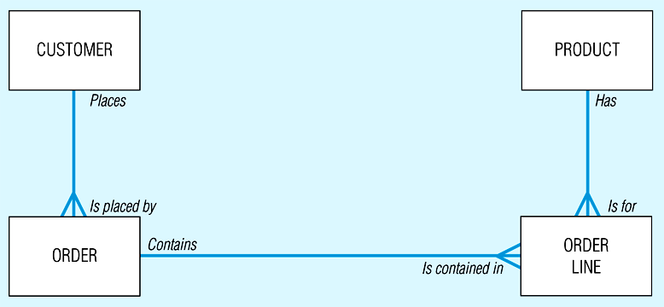
Figure 2-1 Segment from enterprise data model (Pine Valley Furniture Company) [simplified E-R diagram, repeat of figure 1.3]
Enterprise data model describes the entities in an organization and the relationship between these entities

Slide 10
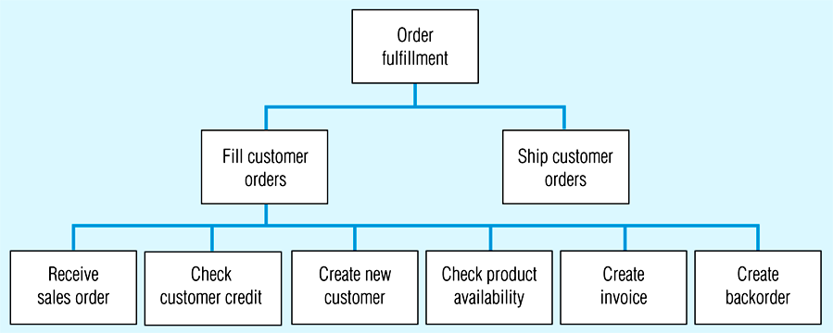
Figure 2.2 -- Example of process decomposition of an order fulfillment function (Pine Valley Furniture)
Decomposition -- breaking large tasks into smaller tasks in a hierarchical structure chart

Slide 11
Planning Matrixes
Function-to-data entity
Location-to-function
Unit-to-function
IS-to-data entity
Supporting function-to-data entity
  which data are captured, used, updated, deleted within each function
IS-to-business objective

Slide 12
Example business function-to-data entity matrix (fig. 2.3)
Customer
Product
Raw Material
Order
Work Center
Work Order
Invoice
Equipment
Employee
Data Entity
Types
Business
Function (users)
Business Planning X X X X
Product Development X X X X
Materials Management X X X X X X
Order Fulfillment X X X X X X X X X
Order Shipment X X X X X X
Sales Summarization X X X X X
Production Operations X X X X X X X
Finance and Accounting X X X X X X X X

Slide 13
Alternative Approaches to Database and IS Development
SDLC
  System Development Life cycle
  Detailed, well-planned development process
  Time-consuming, but comprehensive
  Long development cycle
Prototyping
  Rapid application development (RAD)
  Cursory attempt at conceptual data modeling.
  Define database during development of initial prototype.
  Repeat implementation and maintenance activities with new prototype versions.

Slide 14
Systems Development Life Cycle
(figures 2.4, 2.5)
Project Identification
and Selection
Project Initiation
and Planning
Analysis
Logical Design
Physical Design
Implementation
Maintenance

Slide 15
Systems Development Life Cycle
(figures 2.4, 2.5)
Project Identification
and Selection
Purpose --preliminary understanding
Deliverable –request for project
Project Initiation
and Planning
Analysis
Logical Design
Physical Design
Database activity –
enterprise modeling
Implementation
Maintenance

Slide 16
Systems Development Life Cycle
(figures 2.4, 2.5)
Project Identification
and Selection
Purpose – state business situation and solution
Deliverable – request for analysis
Project Initiation
and Planning
Analysis
Logical Design
Physical Design
Database activity –
conceptual data modeling
Implementation
Maintenance

Slide 17
Systems Development Life Cycle
(figures 2.4, 2.5)
Project Identification
and Selection
Purpose –thorough analysis
Deliverable – functional system specifications
Project Initiation
and Planning
Analysis
Logical Design
Physical Design
Database activity –
conceptual data modeling
Implementation
Maintenance

Slide 18
Systems Development Life Cycle
(figures 2.4, 2.5)
Project Identification
and Selection
Purpose –information requirements structure
Deliverable – detailed design specifications
Project Initiation
and Planning
Analysis
Logical Design
Physical Design
Database activity –
logical database design
Implementation
Maintenance

Slide 19
Systems Development Life Cycle
(figures 2.4, 2.5)
Project Identification
and Selection
Purpose –develop technology specs
Deliverable – program/data structures, technology purchases, organization redesigns
Project Initiation
and Planning
Analysis
Logical Design
Physical Design
Database activity –
physical database design
Implementation
Maintenance

Slide 20
Systems Development Life Cycle
(figures 2.4, 2.5)
Purpose –programming, testing, training, installation, documenting
Deliverable – operational programs, documentation, training materials
Project Identification
and Selection
Project Initiation
and Planning
Analysis
Logical Design
Physical Design
Database activity –
database implementation
Implementation
Maintenance

Slide 21
Systems Development Life Cycle
(figures 2.4, 2.5)
Project Identification
and Selection
Purpose –monitor, repair, enhance
Deliverable – periodic audits
Project Initiation
and Planning
Analysis
Logical Design
Physical Design
Database activity –
database maintenance
Implementation
Maintenance

Slide 22
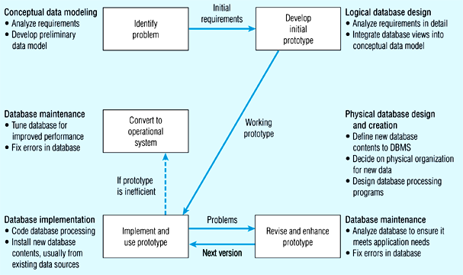
Figure 2-6 The prototyping methodology and database development process

Slide 23
Figure 2-6 The prototyping methodology and database development process

Slide 24
Figure 2-6 The prototyping methodology and database development process

Slide 25
Figure 2-6 The prototyping methodology and database development process

Slide 26
Figure 2-6 The prototyping methodology and database development process

Slide 27
Managing Projects:
People Involved
Systems analysts
Database analysts
Users
Programmers
Database/data administrators
Systems programmers, network administrators, testers, technical writers

Slide 28
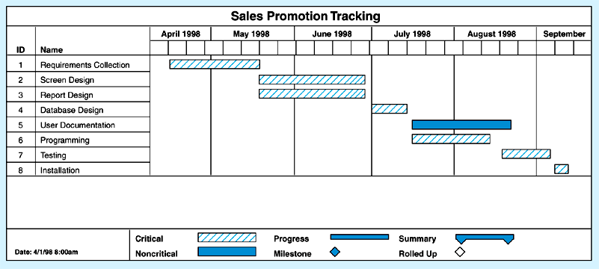
Figure 2-7a Gantt Chart
Shows time estimates of tasks

Slide 29
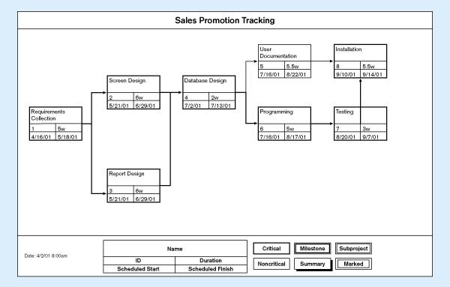
Figure 2-7b PERT chart
Shows dependencies between tasks

Slide 30
Database Schema
Physical Schema
  Physical structures – covered in chapters 5 and 6
Conceptual Schema
  ER models – covered in chapters 3 and 4
External Schema
  User Views
  Subsets of Conceptual Schema
  Can be determined from business-function/data entity matrices
  DBA determines schema for different users
  This is part of people-management in databases

Slide 31
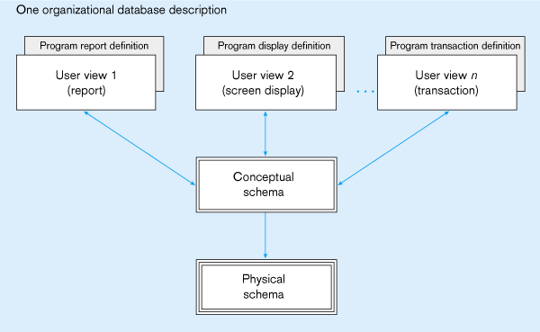
Figure 2-8 Three-schema database architecture
External schema
Different people have different views of the database…these are the external schema
Internal schema

Slide 32
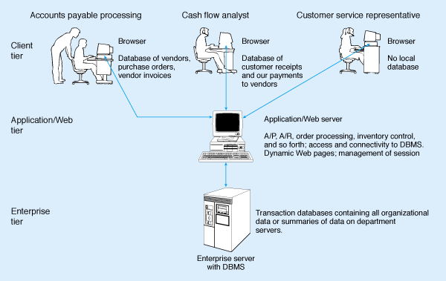
Figure 2-10 Three-tiered client/server database architecture

Slide 33
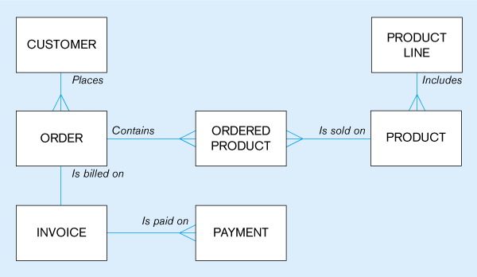
Pine Valley Furniture
Preliminary data model
(figure 2-11)

Slide 34
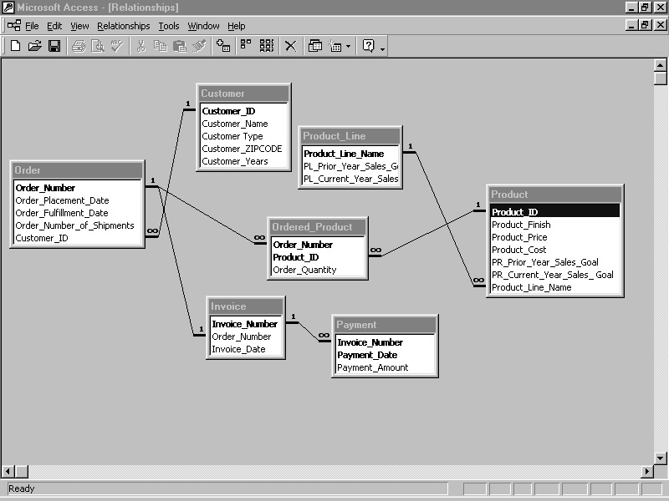
Pine Valley Furniture
MS Access data model prototype (figure 2-14)

